Slide 1
Internet of things
Computer Literacy

Slide 2

Cisco Commercial

Slide 3
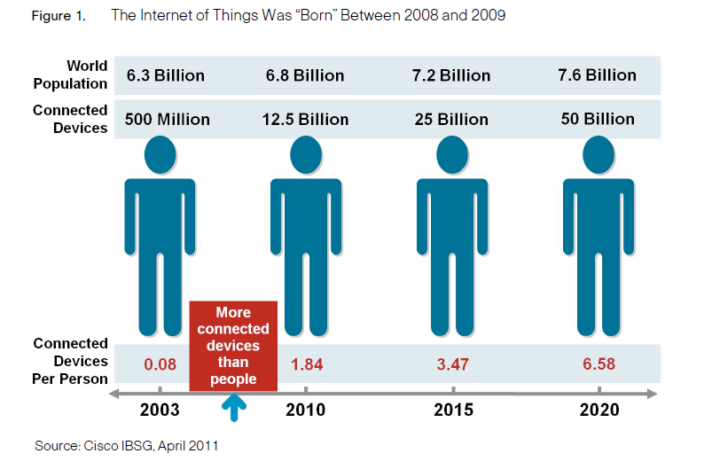
Birth of IOT

Slide 4
Internet of Things
Beyond human communication
Communication between devices
People-to-people
People-to-things
Things-to-things

Slide 5
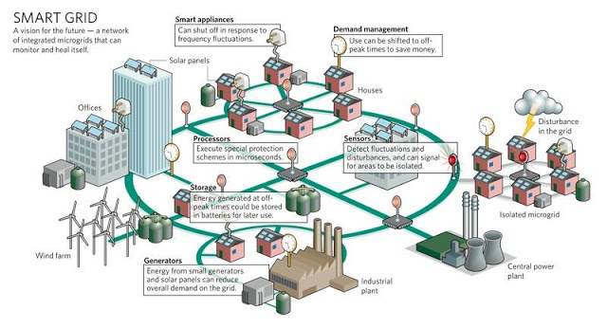
Smart Grid

Slide 6
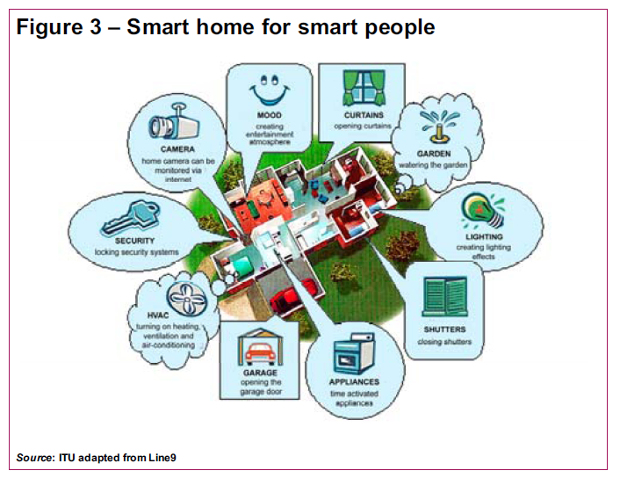
Smart Home

Slide 7
Applications
Environmental or habitat monitoring
Scientific, ecological applications
Seismic detection
Surveillance and tracking
Intrusion detection
Pursuer-evader
Smart environments
Agriculture
Manufacturing / Industry
Smart Grid
Medical applications
Hospital or clinic
Retirement / Assisted Living
Many others…

Slide 8
IOT – network of smart objects
IoT is a network of smart objects.
A smart object is a tiny, low cost computer that may contain:
A sensor which may contain physical data (e.g., temperature, vibration, pollution, camera, microphone, GPS)
An actuator capable of performing a task (e.g., change traffic lights, rotate a mirror)
A communication device to receive instructions, send data, or route information
This device is embedded into objects to make them “smart”.
Thermometers, car engines, light switches, gas meters

Slide 9
Smart Object Characteristics
Small in size
Limited CPU power
Limited Memory
Limited Bandwidth
May operate in harsh environments
Power consumption is critical – battery may need to last for a few years

Slide 10
Wireless Sensor Networks
A distributed connection of nodes that coordinate to perform a common task
Nodes can sensory information, perform some processing, and communicate with other nodes
Enabling technologies (designed for nodes with limitations)
Bluetooth
Zigbee
RFID

Slide 11
Scenario: Shopping
Entering store, scanners will identify tags on our clothes
Goods will introduce themselves
Exiting store, scanners detect merchandise that you have and automatically charge your credit card

